Slide 1
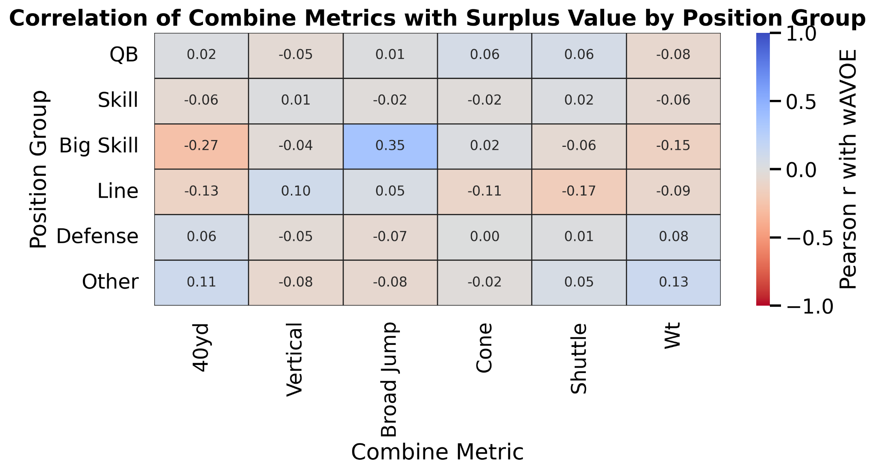
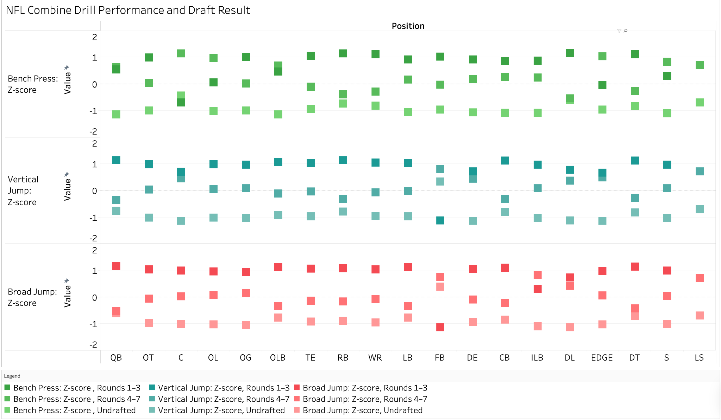
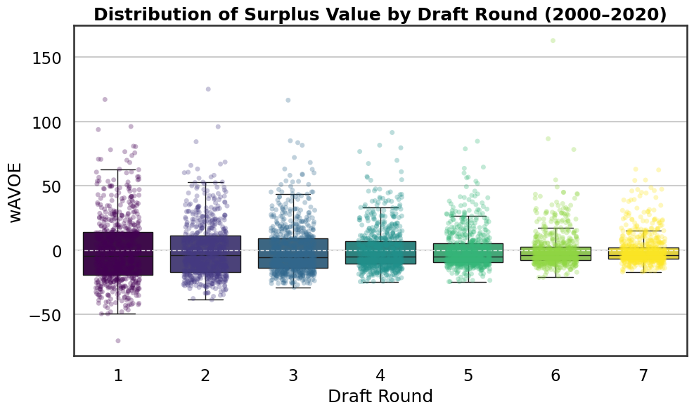
The Fantastic Four
Combine Correlations
Drill vs Draft Result
Skill: RB, WR, TE
Big skill: FB, TE
Round vs wAVOE
waVOE (weighted approximate value over expected): measures how much a player over- or under-performed relative to the historical average for their draft slot.

